Slide 1
Chapter 17: Views
2023

Slide 2
Chapter 17: Views
Contents:
Introduction to views
Creating views
Viewing data using a view
Updating a view
Materialized views

Slide 3
Views
A VIEW in SQL Server is like a virtual table that contains data from one or multiple tables.
You can get the result set by creating a query with the data from one or more tables using the SELECT statement.
For example, the following statement returns the product name, brand, and list price of all products from the products and brands tables:
SELECT
product_name, brand_name, list_price
FROM products p
INNER JOIN brands b
ON b.brand_id = p.brand_id;
Notes:
Advantages:
Security: You can limit users' direct access to the table and allow access to a subset of the data through the view. For example, you can allow users access to customer names, phone numbers, and email addresses from the view, and restrict access
It’s Simple and not complex: A relational database can contain many tables with complex relationships such as: B. One-on-one that makes navigation difficult.
Consistency: You may need to create complex formulas and logic in every query. For consistency, you can hide the logic and calculations of complex queries in the view. After defining a view, you can reference the logic from within the view instead of rewriting the logic in a separate query.

Slide 4
Views continued..
The next time you need the same result set, you can save this query to a text file, open it, and run it again.
SQL Server provides a better way to store this query through a view in the database catalog.
The view is a named query that is stored in the database catalog for later reference.
Advantages of a view:
Security
It’s Simple and not complex
Consistency

Slide 5
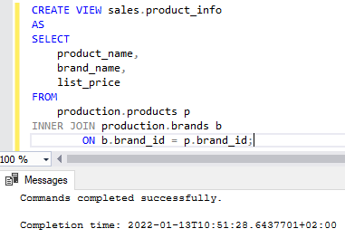
Create a View Example
1. Create the view

Slide 6
Create a view Example
CREATE VIEW view_name AS SELECT column1, column2, ... FROM table_name WHERE condition;
CREATE VIEW [Brazil Customers] AS SELECT CustomerName, ContactName FROM Customers WHERE Country = 'Brazil';
Notes:
In SQL, a view is a virtual table based on the result-set of an SQL statement.
A view contains rows and columns, just like a real table. The fields in a view are fields from one or more real tables in the database.
You can add SQL functions, WHERE, and JOIN statements to a view and present the data as if the data were coming from one single table.
It’s basically a table that only exists when you use the view in a query
A view is also updateable:
THEN temp tables?

Slide 7
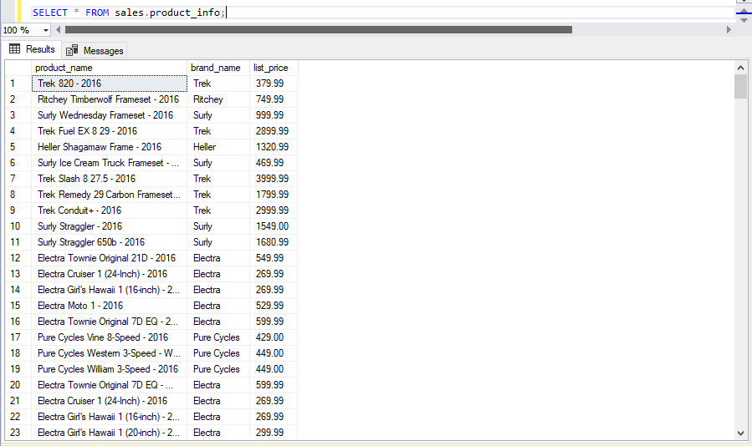
Viewing the view
2. you can reference to the view in the SELECT statement like a table

Slide 8
Views (creating and running views)
CREATE VIEW view_name AS
SELECT column1, column2, ...
FROM table_name
WHERE condition;
CREATE VIEW [Products Above Average Price] AS
SELECT ProductName, Price
FROM Products
WHERE Price > (SELECT AVG(Price) FROM Products);
SELECT * FROM [Products Above Average Price];
CREATE VIEW [Brazil Customers] AS
SELECT CustomerName, ContactName
FROM Customers
WHERE Country = 'Brazil’;
SELECT * FROM [Brazil Customers];

Slide 9
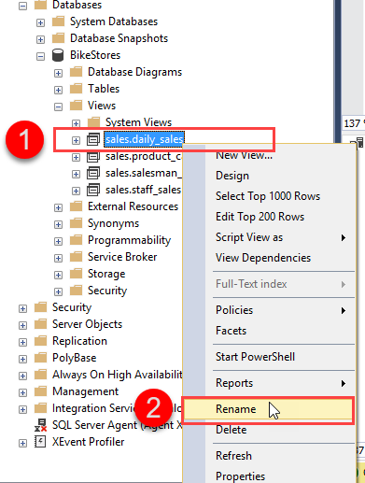
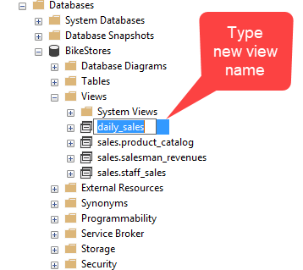
Rename view
First, in Object Explorer, expand the Databases, choose the database name which contains the view that you want to rename and expand the Views folder.
Second, right-click the view that you want to rename and select Rename.

Slide 10
Updating/Deleting views
A view can be updated with the CREATE OR REPLACE VIEW statement
CREATE OR REPLACE VIEW view_name AS
SELECT column1, column2, ...
FROM table_name
WHERE condition;
Deleting a view
DROP VIEW view_name;
DROP VIEW [Brazil Customers];
CREATE OR REPLACE VIEW [Brazil Customers] AS
SELECT CustomerName, ContactName, City
FROM Customers
WHERE Country = 'Brazil'

Slide 11
Updating a view
CREATE OR REPLACE VIEW view_name AS SELECT column1, column2, ... FROM table_name WHERE condition;
CREATE OR REPLACE VIEW [Brazil Customers] AS SELECT CustomerName, ContactName, City FROM Customers WHERE Country = 'Brazil';

Slide 12
Drop view
To remove a view from a database, you use the DROP VIEW statement as follows:
The syntax: DROP VIEW [IF EXISTS] schema_name.view_name;
The above syntax specifies the name of the view to remove after the DROPVIEW keyword.
If the view belongs to a schema, you must also explicitly specify the name of the schema to which the view belongs.

Slide 13
Dropping a view
DROP VIEW view_name;
DROP VIEW [Brazil Customers];

Slide 14
SQL Server returns an error when trying to delete a view that does not exist.
The IF EXISTS clause prevents you from getting an error when you delete a view that does not exist.
The syntax to drop multiple views:
DROP VIEW [IF EXISTS] schema_name.view_name1, schema_name.view_name2,...;
Notes:
Example: Drop single view: DROP VIEW IF EXISTS sales.daily_sales;
Drop multiple views:
DROP VIEW IF EXISTS
sales.staff_sales,
sales.product_catalogs;

Slide 15
views
Create a view called listings_under_100 where the query is all listings that are below 100 in price.
Create a view called listings_private_rooms where the query is all listings that are private rooms.
Delete the view listings_under_100.
Update the view listings_private_rooms to show hotel rooms
Notes:
Answer
DECLARE
@local_time DATETIME
@utc_time DATETIME;
SET @local_time = GETDATE();
SET @utc_time = GETUTCDATE();
SELECT
CONVERT(VARCHAR(40) @local_time)
AS Server local time ;
SELECT
CONVERT(VARCHAR(40) @utc_time)
AS Server UTC time
SELECT
CONVERT(VARCHAR(40) DATEDIFF(hour @utc_time @local_time))
AS Server time zone ;
GO

Slide 16
Materialized views
A materialized view is a database object that contains the result of a query that has been precomputed and stored in the database. Materialized views can be thought of as a cache of query results that can be used to improve performance and reduce the workload on the database server.
CREATE MATERIALIZED VIEW mv_sales_by_region
AS
SELECT region, SUM(sales) AS total_sales
FROM sales_table
GROUP BY region;
Notes:
[Not great for live stats, unless incorporated in stored procedures or scheduled refreshes]
It improves the performance of complex queries (typically queries with joins and aggregations) while offering simple maintenance operations.
Unlike a regular view, which is just a stored query that is executed when it is called, a materialized view stores the results of the query in a table-like structure that can be indexed, partitioned, and optimized for query performance.

Slide 17
Once the materialized view is created, you can refresh it using the REFRESH MATERIALIZED VIEW statement, which updates the view with the latest data from the underlying table(s).
REFRESH MATERIALIZED VIEW mv_sales_by_region;
Notes:
You can also specify the refresh method when creating the materialized view, such as refresh on demand or refresh on a schedule.

